Slide 1
Smart Dustbin
Presented By :-
Abhishek Kumar

Slide 2
INTRODUCTION
This project aims to make the use of dustbin in easier and efficient way.
Especially in this covid situation, I tried to make a safe medical waste disposal system, which can be easily used in hospitals and other small healthcare units.
The system will be fully automatic which will avoid any physical touch of humans.
The main component used for designing the system will be Arduino.

Slide 3
Literature Survey
The significance of this idea is to achieve a handsfree system to minimise the human contact with the medical waste.
Similar projects are being worked on by people across the globe and also have been successfully implemented in few of them.
Healthcare being the topmost priority sector in today's era is the theme of our project in the broader sense.

Slide 4
Motivation
With the rise in demand of automation in almost every industry I have tried to put it to use in the healthcare sector.
As the ongoing pandemic situation still prevails, the aim has been to reduce the frequency of touching of objects kept in public places by people with bare hands(such as dustbins in healthcare units).

Slide 5
Objectives
To reduce human effort of opening and closing bin shafts
To reduce the repeated contact of people with objects such as dustbins which will reduce the chances of spreading of any infectious disease.
To pave the pathway for automation in the disposable systems in future.
This will be a great help towards the over burdened medical staff of our country if we can contribute to contain the situation from worsening in whatever way we can.

Slide 6
Methodology
The system will use a Ultrasonic sensor to detect any object within a close predefined proximity of the bin.
After detecting the object, the arduino will trigger the shaft which will rise up for the person to dispose off the waste.
Once the waste is disposed and the person walks away from the predefined detecting range of sensor the shaft of the bin will move down and close(via trigerring by arduino).
As a result, a touchfree disposal of medical waste or any other waste material can be achieved. Hence, the safety of the people is ensured.

Slide 7
Work Done Till Date
I have gathered all of the components required to complete the project successfully.
I have successfully assembled the components and checked the functioning of the dustbin.
The circuit diagram of the system has been attached in the next slide with some glimpses of the prototype developed.

Slide 8
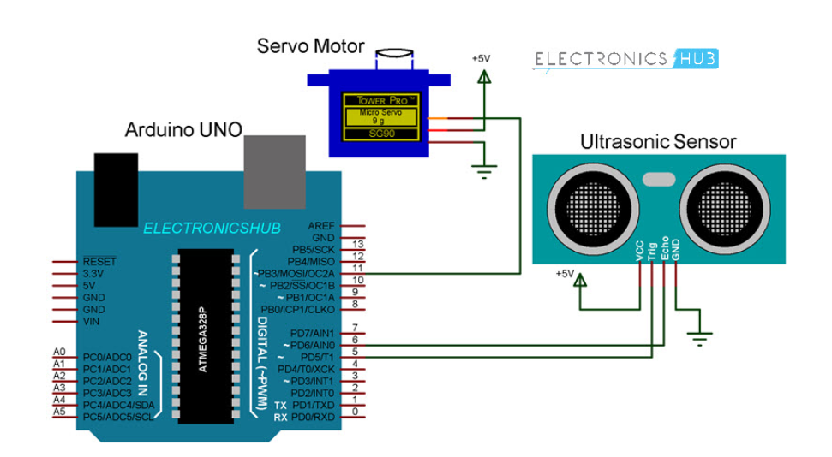
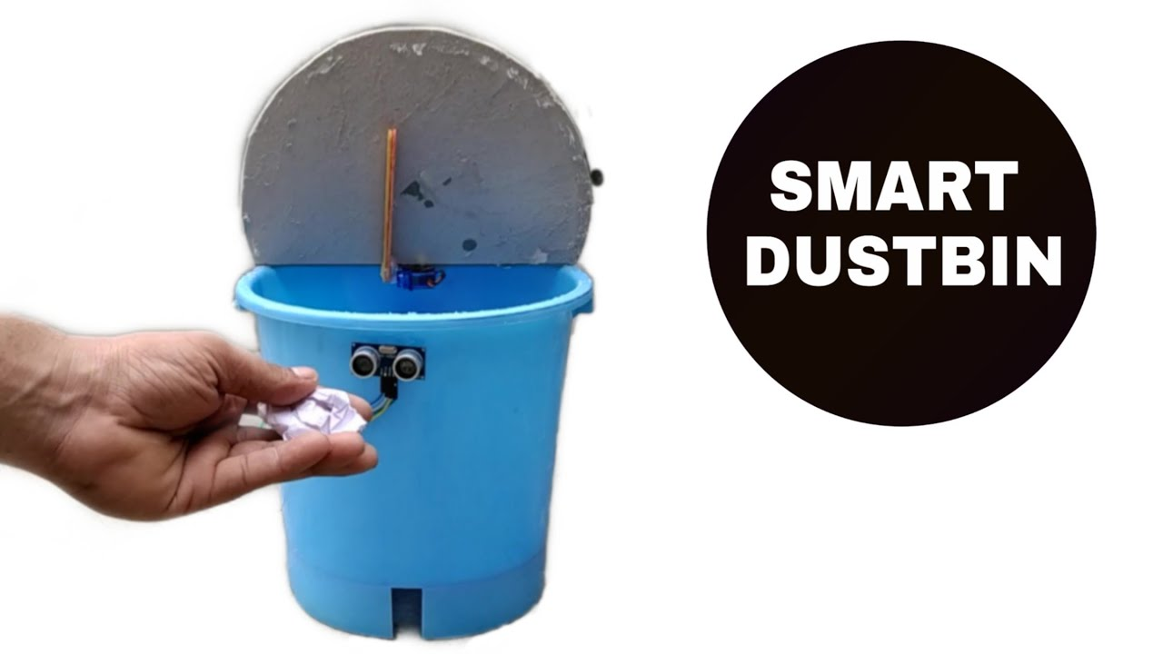
Circuit Diagram and the Prototype

Slide 9
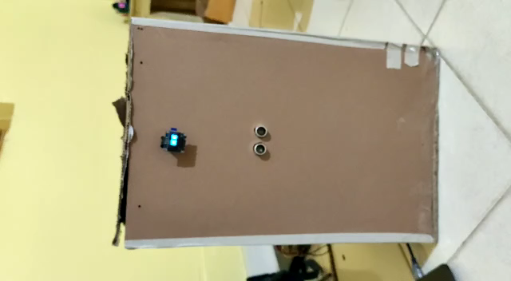

Slide 10
Scope For Future Work
We can incorporate a feature to the dustbin which will check the status or level of the waste filled in it. Once the waste collected in the dustbin exceeds beyond a threshold the concerned medical staff would dispose off the waste at the right dumping yard at once.
By introducing this feature we can make this system more interactive and effective towards the user and will also be much easier to operate with a close monitor attached.

Slide 11
Conclusion
A very useful project in the name of Smart Dustbin using Arduino is designed and developed.
In general the shaft of the dustbin will be closed so that waste is not exposed(to avoid flies and mosquitoes) and the shaft will automatically move up when the sensor detects an object(human in our case) in motion within its range.
In the present scenario it is an effective method waste disposal as it is contactless. These dustbins can be installed in hospitals or even in small healthcare units setup by government to deal with the COVID-19 situation leading to a safer environment for frontline health workers.

Slide 12
References
https://www.electronicshub.org/smart-dustbin-using-arduino/
https://www.instructables.com/Smart-Dustbin/

Slide 13
THANK
YOU

